Slide 1


JUST BASH IT!

Slide 2



WHO ARE WE?
HEADS (SUND) DATA LAB
WEBSITE: https://heads.ku.dk/
Center for Health Data Science (HeaDS)
Data Lab Supports Researchers at the Faculty
Consultation, Commission & Collaboration:
Data science and bioinformatics analyses
Teaching: Courses & Workshops, Seminars
KUB DATA LAB
Henrike Zschach
Thilde Terkelsen

Slide 3


WHO ARE WE?
KUB DATA LAB
WEBSITE: https://kub.kb.dk/datalab
KUB Datalab is an open space for learning - both KU students and teachers
Data wrangling: harvest, clean, analyse, and visualise data (novice and experienced)
Free courses and learning activities
Christian B. Knudsen
Daniel Pryn

Slide 4
WHO ARE WE?
Big Data Management Platform
WEBSITE: ???
Some description of the platform’s activities or what you want here
David Galligani

Slide 5
JUST BASH IT!
PROGRAM
Day 1
Day 2
08:45 | MORNING COFFEE
09:00 | INTRODUCTION TO COMMANDLINE
09:15 | PART 1: NAVIGATING FILES & DIRECTORIES
09:35 | EXERCISE 1
10:00 | PART 2: FILE OPERATIONS
10:15 | EXERCISE 2
10:30 | COFFEE BREAK
10:45 | PART 3: PROJECT ORGANIZATION & BACKUP
11:05 | EXERCISE 3
11:30 | PART 4: VIEWING AND EDITING FILES
12:00 | LUNCH
13:00 | EXERCISE 4
13:20 | PART 5: DATA WRANGLING
13:45 | COFFEE BREAK
14:00 | EXERCISE 5
15:00 | Q + A
15:30 | SEE YOU TOMORROW
08:45 | MORNING COFFEE
09:00 | PART 6: DATA WRANGLING 2
09:25 | EXERCISE 6
10:25 | COFFEE BREAK
10:40 | PART 7: REDIRECTION & PIPES
11:00 | EXERCISE 7
12:00 | LUNCH
13:00 | PART 8: SHELL SCRIPTS & LOOPS
13:30 | EXERCISE 8
14:15 | COFFEE BREAK
14:30 | PART 9: INSTALLATIONS, CONFIG FILES, WORKFLOW LANGUAGE
15:00 | EXERCISE 9
15:30 | BYE BYE
COURSE MATERIALS:
https://github.com/Center-for-Health-Data-Science/Just-Bash-It

Slide 6
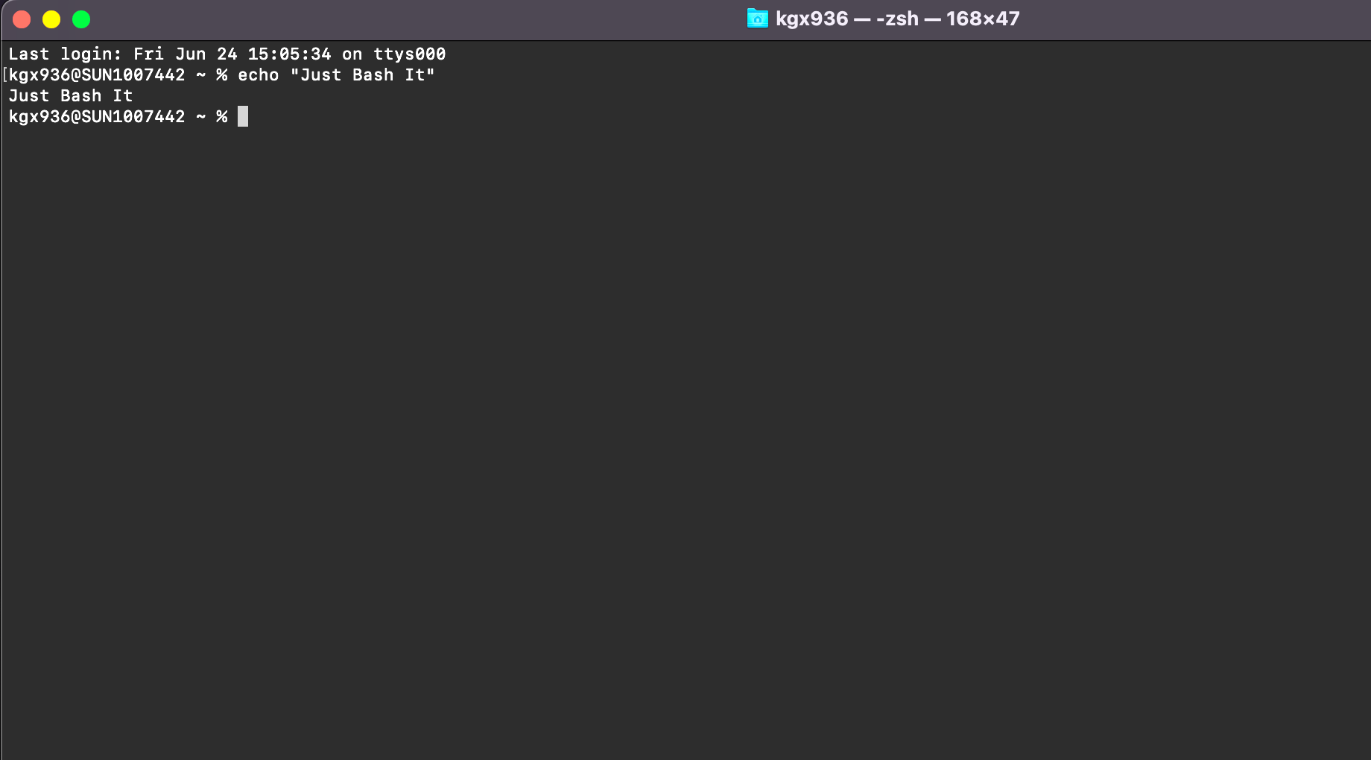
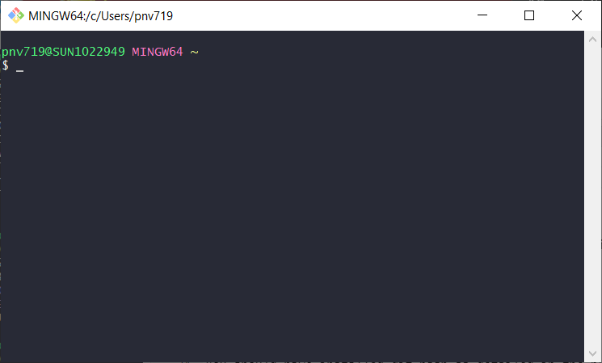
SET UP CHECK
You should all have a terminal. It looks like this:
During this course we will do exercises inside the terminal.
But we will also show commands during the lecture. We encourage you to have your terminal open and try them out as we go along.

Slide 7
“
“What is a shell, a terminal, a command-line, and what is bash?”
“How do these concepts connected to my computer?”

Slide 8
WHAT IS BASH?
In the beginning there was the word –
Not the graphical user interface!
The first computers had no graphical interfaces where you could click around. Instead, you interacted with the computer via the terminal.
There are still computing environments that do not have a GUI, such as HPC systems. Many scientific programs do not have a GUI either. You need to execute them via the terminal.

Slide 9
TERMINOLOGY
COMPUTER (Hardware)
BASH SHELL &
COMMAND INTEPRETER
OPERATING SYSTEM (GUI)
$_
TERMINAL -
WRAPPER FOR SHELL
FILES & SOFTWARE *
You open the terminal on your computer
Into the terminal you type bash commands
Commands are interpreted by the shell
>
* These might seem very different, but really software is just an executable file.
Notes:
Operating system may use a command-line interface (CLI) or graphical user interface (GUI).
Unix & Linux operating systems are CLI.
Windows, Mac OSX, Ubuntu, etc. are GUI.
Bash is a shell & command-line interpreter which interacts with the operating system on a computer.
Bash (Bourne again shell) is based on the Bourne shell (sh).
Bash is used though a wrapper program which provides a text window, the terminal, where the user types commands which in terms cause actions on a computer.
Accesses runs softwares installed
File viewing & manipulation
The Bash shell is the default shell for the linux & unix operating systems. This is why you often hear these mentioned together, however most operating systems (also those with GUIs), contain a shell, where bash is the most popular.
Default on OSX and Ubuntu
Windows has a native windows shell as default, but a bash shell may easily be installed.

Slide 10
Flexible and works on any system
Automatised and Reproducible
SELL IT TO ME!
Benefits of bash & command line:
Your analysis will be reproducible, automated and parallelised.
Fast processes, less computationally intensive.
Command line softwares.
Power to handle big data and heavy computations.
Not Resource Intensive
and Fast
Wind
Software & Big Datasets
Server, HPC & Cloud Compute Power

Slide 11
A COUPLE OF EXAMPLES
1
2
3
REGISTRY DATA
SEQUENCING DATA
DATABASES
Drug adverse effects and mortality:
Person sensitive
Huge files, many columns
Different formats
Single Cell RNA from Cystic Fibrosis:
Paired-end sequencing
300 patients
Two fastq files per patient
Drug Databases - molecular structure & interaction:
Multiple large databases
Different formats
Maybe not downloadable

Slide 12
HOW DO I GET A BASH SHELL?
>= WINDOWS 10 - Windows Subsystem for Linux:
(https://adamtheautomator.com/windows-subsystem-for-linux/ ).
OR INSTALL A BASH SHELL/TERMINAL:
Gitbash: https://gitforwindows.org
MobaXterm: https://mobaxterm.mobatek.net/download.html
Cygwin: https://www.cygwin.com/index.html
Cmder: https://cmder.net/
PuTTY: https://www.putty.org/
YEAH!
YOU HAVE A BASH SHELL & TERMINAL ALREADY.
Search for terminal on your laptop and open it.
OS X or UBUNTU
WINDOWS
In this course Windows users will be working on gitbash.

Slide 13
WHAT WILL I LEARN IN THIS COURSE?
STORAGE,
BACKUP & MORE…
SCRIPTS &
AUTOMATIZATION
MORE BASH
COMMANDS
ORGANIZATION
& STRUCTURE
The BASICS
OF BASH
Manage Software
Workflows
Backups
Computing Power
Stdin & Stdout
Piping
Loops & Scripts
Pipelines
Manipulate files
Subset, Count
Print, Sort, Match
Cut, Paste, Split
Directory Structure
Paths & Permission
Reproducibility
The terminology
Navigation w. bash
Read, Edit, Copy

Slide 14
1. NAVIGATING
FILES & DIRECTORIES

Slide 15




THE ANATOMY OF A COMPUTER
Software
henrike
Data
Documents
Pictures
Hardware
Exp1.csv
Teaching
Research
CPU + RAM
Hard drive
my_data.csv
File tree

Slide 16
THE FILE TREE
File systems are structured as hierarchical trees.
Every file and folder has an exact 'address' on the disk called a path.
henrike
YEAH!
YOU HAVE A BASH SHELL & TERMINAL ALREADY.
Data
Documents
Pictures
Exp1.csv
Teaching
Research
my_data.csv
File tree

Slide 17
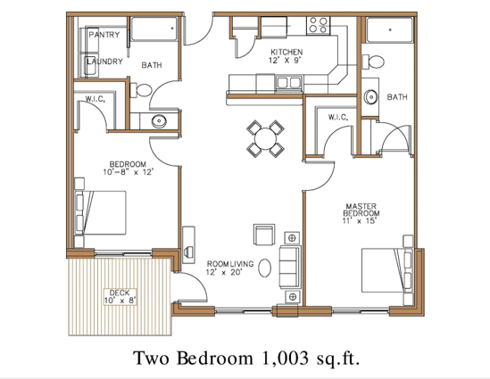
THE FILE TREE
You can think of the file tree like the floor plan of a house:
Rooms and items are in specific places. The bed i.e. is in the bedroom.
You are always in a specific room. You cannot be in two different rooms at the same time.
In order to interact with items, you need to know where in your house it is.
Items can be moved from one room to another.
YEAH!
YOU HAVE A BASH SHELL & TERMINAL ALREADY.

Slide 18
THE FILE TREE
A loose translation of the floor plan into a directory tree:
The directory tree is hierarchical and starts at the ‘root’ = ‘/’
/
Kitchen
Living room
Bathroom
Master Bedroom
my_bed.csv

Slide 19
THE HOME DIRECTORY
The home directory is a special place in the file tree. It is a folder named with your user name that is typically a subfolder of the ‘users’ folder.
This is where you will be when you open your terminal
The path to the home directory can be abbreviated with the tilde symbol: ~ .
You may notice this symbol later when looking at your current working directory or changing to another directory.
/
Users
[you]
Data
Documents
Pictures
Notes:
* Depending on your system the structure might be bit different from the illustration.

Slide 20
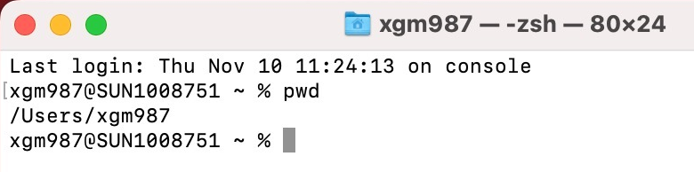
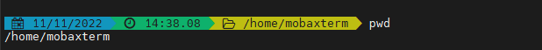
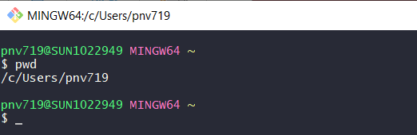
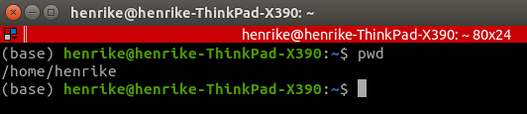
THE HOME DIRECTORY
What the home directory is called can differ between operating systems and computers! Do not be too bothered by that. All home directories are beautiful <3!
As a rule of thumb, the home directory is generally two steps from the root '/' and it is personal. When there are several users on the same machine each has their own home directory.
Notes:
* Depending on your system the structure might be bit different from the illustration.

Slide 21
CURRENT DIRECTORY
Remember we said the file tree is similar to a house. When you operate on the terminal you are always located in a certain directory i.e. room.
The directory you are currently in is called the working directory and you can print it with:
$ pwd
/
Users
[you]
The scheme shown here and on the following slides corresponds to what you have in the ‘Files’ folder of the git hub repo. Sometimes not all folders are shown on the scheme.
Data
Documents
Pictures
Notes:
* Depending on your system the structure might be bit different from the illustration.

Slide 22
LISTING CONTENT
To list the contents of a directory, including other directories, use the command:
$ ls
In the example sketched on the right this would give you the Downloads, Documents and Pictures folders.
You can also list other directories that you are NOT currently inside of by specifying the path to them:
$ ls /Users $ ls ~/Downloads
ls has many useful options such as –l, -t and –h, -F. We’ll get to that later.
/
Users
[you]
Data
Documents
Pictures
Notes:
We’ll talk about paths in a bit

Slide 23
CHANGING DIRECTORIES
From your wd, you can easily move into any subdirectory:
$ cd Documents
/
You can also move several directories down:
$ cd Documents/courses
Users
tmp
To move ‘up' in the directory tree you need to use '../' . Each time you write this, you go one level up.
$ cd ../tmp
[you]
Data
Documents
Pictures
Courses
Projects

Slide 24
CHANGING DIRECTORIES
/
cd without any arguments will always bring you to your home directory, no matter what your current directory is:
$ cd
Users
tmp
cd with a minus will bring you back to the last directory you came from:
$ cd -
[you]
Data
Documents
Pictures
Courses
Projects

Slide 25
PATHS
Each file and directory exist in one specific place on your computer. One could say they have an address.
This ‘address’ is called their path. It is an instructions how to find the file or directory.
Following the example from earlier, the path to you bed would be:
/entrance/living_room/Bedroom/bed.txt

Slide 26
PATHS
Paths can be full/absolute or relative.
Full paths always start at the root. Since ~ represents the path to your home directory it naturally includes the root. So
/Users/[you]/Documents
and
~/Documents
Are the same place and the same path and are full paths.
Full paths are always unambiguous since they describe the entire 'journey' starting from the root.
/
Users
tmp
[you]
Data
Documents
Pictures
Courses
Projects

Slide 27
PATHS
A relative paths is an address relative to the current working directory.
If my working directory is ‘Documents’, I can address the file ‘Commandline.pptx’ as:
courses/Just-Bash-It/Commandline.pptx
[you]
1
Data
Documents
Pictures
Relative paths can include going up the directory tree:
../Pictures/summer2022/Bornholm
This notation does not make sense for full paths as they start from the root and go strictly downwards.
2
Courses
Projects
summer2022
2
Just-Bash-It
Bornholm
1
Commandline.pptx

Slide 28
COMMANDS
We interact with the computer by issuing commands to it. You have already tried some like cd, ls, pwd.
Some commands can stand by themselves like pwd, but often they have arguments and options/flags:
$ ls –lh ~/Documents/courses
The command:
List contents
The options/flags:
Long format &
Human-readable size
The argument:
Path to the directory to work on
Whenever we put a space it means we are proceeding to another part of the command. This is why file and directory names cannot contain spaces, they will be mis-interpreted!

Slide 29
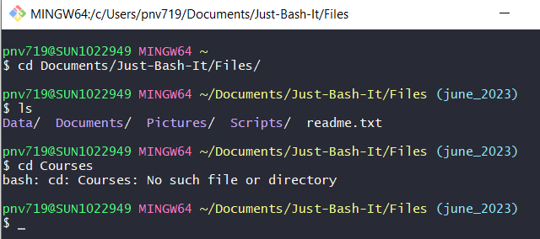
WHEN THINGS GO WRONG
Assuming I am in my home directory and I write:
$ cd courses
What will happen?
/
Users
tmp
[you]
Data
Documents
Pictures
Courses
Projects

Slide 30
WHEN THINGS GO WRONG
1
Don’t panic!
2
Read the error message
3
Try to correct your error
4
If lost, google or read the help page

Slide 31
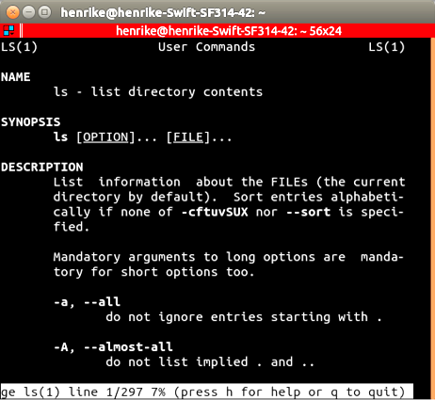
GETTING HELP
Many commands have a help page, i.e. a manual. You can call it with man:
$ man ls
The man page includes:
A description of what the command does
Explanation for arguments
Usage examples (the syntax of the command, what goes where)
man is not included in git bash but you can try --help or -h instead. Some commands also don’t have a man page.
You can always search the web if all else fails!

Slide 32
CHEAT SHEET 1
pwd # print working dir
cd # go to home dir
cd [path] # change dir (remember path)
ls # list dir content
man [cmd] # get info about command
[cmd] --help # view the help for command
WHERE & WHAT
FILE/DIR BASICS

Slide 33
“
Let’s Bash it!
Open your terminal on your computer and do exercise 1. We’re here to help if you get stuck!

Slide 34
2. FILE OPERATIONS

Slide 35

MOVING FILES AND DIRS
For this part, lets go into the ‘Documents' folder under the ‘Files’ of the github repo.
You can move files (and directories) from one place into another with mv:
$ mv pancakes.txt ../recipies
Documents
mv can also be used for renaming:
$ mv pancakes.txt egg_cakes.txt
bills
recipies
Do not try to move or remove your home directory or other system critical dirs. This may have unintended consequences.
pancakes.txt
pancakes.txt
egg_cakes.txt

Slide 36
COPY
Files can be duplicated with the cp command. The first argument is the file you want to copy, the second argument is the destination, i.e. the name of the copy.
$ cp egg_cakes.txt new_recipy.txt
Documents
To copy a directory (and all its contents!) you need the –r flag:
$ cp -r recipies recipies_copy
bills
recipies
recipies_copy
You always need to specify a destination when you use copy. The destination can be the name of the new file, but it can also be another directory to copy the file to:
egg_cakes.txt
new_recipy.txt
$ cp egg_cakes.txt ../recipies_copy/

Slide 37
REMOVE
To remove files and dirs, use rm
$ rm new_recipy.txt
Documents
Just like when copying, you need the -r flag when removing a directory:
$ rm -r recipies
bills
recipies
recipies_copy
Unlike in many graphical file managers, rm is permanent! You cannot recover a removed file and you will not be asked whether you are sure you want it gone.
egg_cakes.txt
new_recipy.txt

Slide 38
CREATING FILES AND DIRECTORIES
To create a new directory we use mkdir:
$ mkdir new_dir
The new directory will not have any content to start with. There are many ways to create files, mostly as output from programs (we’ll get to that later), but you can always create an empty file by using touch:
$ touch a_new_file.txt
Documents
bills
recipies
egg_cakes.txt
new_dir

Slide 39
OPERATING ON SEVERAL FILES
Above we have seen how to interact with single files and directories. But we can also interact with several at once!
This would take all files named something .txt and move them one directory up:
$ mv *.txt ../
The star ‘*’ is called a wildcard. It matches every character (letter, number, ect).
Documents
bills
recipies
buns
.txt
french_
toast
.txt
banana
_bread
.txt
buns.txt
french_toast.txt
banana_bread.txt

Slide 40
OPERATING ON SEVERAL FILES
You can also use the wildcard ‘*’ to restrict actions to certain files and directories.
By default ‘ls’ lists the entire directory. If we only want to see files with names ending in md we can specify that like this:
$ ls *.md
Just-Bash-It
Files
Exercises
.html
Exercises
.md
Readme
.md

Slide 41
CHEAT SHEET 2
pwd # print working dir
cd # go to home dir
cd [path] # change dir (remember path)
ls # list dir content
man [cmd] # get info about command
[cmd] --help # view the help for command
rm [name] # remove file
rm -r [name] # remove dir
cp [name] # copy a file/dir
mv [name] [path] # move file/dir
mkdir [name] # make dir
touch [name] # create file
WHERE & WHAT
FILE/DIR BASICS

Slide 42
“
Let’s Bash it!
Time for exercise 2!

Slide 43
3. PROJECT
ORGANIZATION
& BACKUP

Slide 44

IS YOUR COMPUTER A LAUNDRY BASKET?
Why should I care about directory structure and file naming?
Not nice to not “work” in a mess.
If your computer crashes it is MUCH easier to recover work if files/directories are structured.
If you apply a command (bash, R, Python) to a group of files/directories, naming is important!
Large files should be stored smartly to save space (storage & memory).

Slide 45
DO’S and DON’TS
Consistent and Logical Directory Structure
Don’t Use Symbols or Spaces in File/Directory Names
Consistant & Non-
redundant File Naming
Don’t store multiple copies of file, instead point to it (path).
Version Control System
git/GitHub & Back-up
Don’t Store Large Data/Files on Your Local Computer
Clean and Update Your Computer Regularly
Don’t Store Sensitive Datasets on Your Computer

Slide 46
A SUGGESTION FOR STRUCTURE
LOCAL COMPUTER
HOME
USER
DRIVE
PROJECTS
Name
Results
Scripts
Data
Scratch
Docs
Tables
Figures
Raw
Generated
Literature
Drafts
46
46

Slide 47
STORAGE & BACKUP
BIG DATA & SENSITIVE DATA:
Your own KU drives (S-drive)
ERDA & SIF (KU data storage)
Lab or department server
Lab or department cloud solution
DOCX, EXCEL, POWERPOINT:
Google Drive
Dropbox
KU drives
SCRIPTS:
git/GitHub
(KU drives)
LARGE DATASETS
SENSITIVE DATA
DOCUMENTS & GRAPHICS
SCRIPTS REPORTS

Slide 48


GIT & GITHUB
Git is a version control software, created by Linus Torvalds for the management of the Linux kernel.
Other clients exist.
https://git-scm.com
GitHub is a web-based hosting service for version control that uses git
Other services exist.
https://github.com
git & GitHub not the same

Slide 49
WHAT IS A VERSION CONTROL SYSTEM?
VERSION 3
VERSION 2
FILE
FILE
GIT
VERSION 1
GIT
VERSION 3
VERSION DATABASE
VERSION 3
VERSION 2
GITHUB
VERSION 2
VERSION 1
VERSION 1
VERSION DATABASE
VERSION DATABASE
YOUR COMPUTER
COLLABORATOR

Slide 50

GIT WORKS FROM THE COMMAND LINE
git clone [your repository]
Username: [your user]
Password: [your password]
Git is used from the command line to edit directories & files in a version controlled way
A git command always begins with git
git status (status of the repo)
git add (add new files or changes)
git commit -m (commit the changes)
git push (push the changes to GitHub)
Git enables a local computer to interact with a cloud service (GitHub) to back up your work
Sounds cool, yes!
Take our ‘Introduction to git & GitHub’ Workshop and learn how to git

Slide 51
A SUGGESTION FOR STRUCTURE
LOCAL COMPUTER
EXTERNAL BACKUP
HOME
KU DRIVE
USER
DRIVE
GITHUB
PROJECTS
SERVER
Name
Readme
Results
Scripts
Data
Scratch
Docs
Tables
Figures
Raw
Generated
Literature
Drafts
51

Slide 52
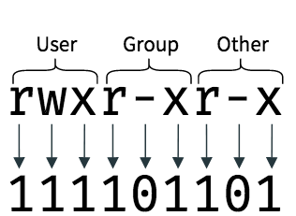
USERS, GROUPS & PERMISSIONS
Files & directories have permission settings which you can see with the ls -l command
Permissions denote who can read, write (edit) and execute a file/dir
On UNIX-based systems (including Mac and HPC systems) you can use the chmod command to set permissions IF your are a system administrator (sys admin).
Private computer : You are sys admin
KU computer : You may be the system admin
Shared KU drives : You are not sys admin
HPCs, Servers & Clouds : You are not sys admin
chmod +rwx [filename]
chmod -wx [directoryname]
chmod u+rw [filename]
chmod g-w [filename]
chmod o-rw [filename]
On Windows chmod does not work since the file system is set up in a different way. There are alternative ways to set permissions with powershell (google that) should you need to.
52

Slide 53
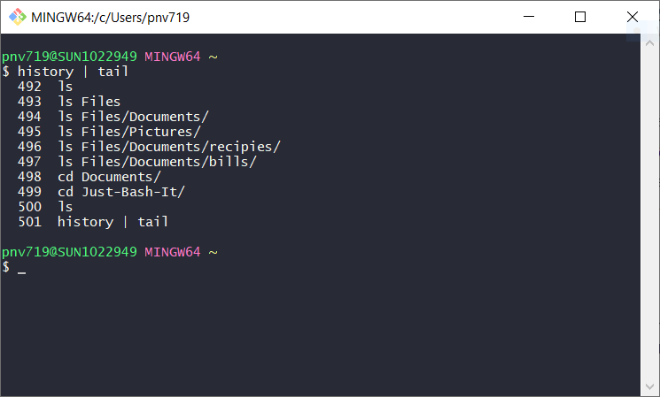
BACK TO THE PAST
“Those who don’t know history are doomed to retype their commands.”
'history’ command brings up a list of previously used commands
The most recent command is last, the oldest command is first
Can use head/tail to only see the beginning/end
Pro tip:
Use the ‘grep’ command to search your history or bring up the interactive ‘reverse-i-search’ with ctrl+r.
53

Slide 54
CHEAT SHEET 3
pwd # print working dir
cd # go to home dir
cd [path] # change dir (remember path)
ls # list dir content
man [cmd] # get info about command
[cmd] --help # view the help for command
rm [name] # remove file or dir
cp [name] # copy a file/dir
mv [name] [path] # move file/dir
touch [name] # make a file
mkdir [name] # make a dir
WHERE & WHAT
FILE/DIR BASICS
SPECIAL CHARACTERS
SIZE & PERMISSION
* # select everything
/ # forward slash paths
\ # escape character (don’t use for now)
.. # one dir up/back
. # current dir
- # denotes a flag/argument
ls -lh * # all sizes
ls -lh [name] # file/dir size
du -sh # disk space
chmod +rwx [name] # add permission
chmod -rwx [name] # remove permission
chmod ugo+rw [name] # specify who, add permission

Slide 55
“
Exercise 3, you know the drill.

Slide 56
4. VIEWING AND EDITING FILES

Slide 57
VIEWING FILES
echo
Many roads lead to Rome… For viewing files we can use:
less [file]:
Prints N first lines of file. You can change the default N. Interactive viewing.
Exit with q
cat [file]:
(concatenation), prints all lines of file.
Exit with ctrl + c
head/tail [file]:
Prints n first / last lines of file. You can change the default n. Static viewing.
less
tail
head
cat
FILE CONTENT
57

Slide 58
VIEW - SUBSET & RENAME
echo
echo 'Hello, World!'
less myfile.txt
cat myfile.txt
less &
cat
Patient | Age | Sex | Smoker | Grade
ID1 | 61 | Female | No | G2
ID2 | 58 | Female | Yes | G3
. | . | . | . | .
> = Redirect - Save output to new file.
More on this later.
head &
tail
head -n 20 myfile.txt
head -n 20 myfile.txt > myfile_small.txt

Slide 59
EDITING FILES
ano
Nano [file]:
Simple and easy to use
Limited functionality
Exit with Ctrl + x (Y + enter)
VIM or VI [file]:
Many functionalities, i.e. complex
Keyboard shortcuts
Exit with :q (:w or :q!)
EMACS [file]:
Oldest editor
Keyboard shortcuts, Ctrl, Alt/Esc + [L]
Exit with Ctrl + x + Ctrl + c (Ctrl + s)
OTHER [file]:
There are many other editors …
IM
Q: What is an editor?
A: Software that allows you to edit a file
macs
OTHER

Slide 60


COMPRESSED FILES
.GZ
Compresses a file with standard gzip (GNU zip) compression.
.TAR
Combines all files within a directory in one, single archive file.
.TAR.GZ
gzip and tar together. Compresses multiple files and puts them into one, single file archive.
Fun fact: tar stands for tape archive

Slide 61
CHEAT SHEET 4
View Files
less [file] # view file content
cat [file] # view file content (full)
head / tail -n 10 [file] # view n first/last lines
nano [file] # https://www.nano-editor.org/dist/latest/cheatsheet.html
vim | vi [file] # https://vim.rtorr.com/
gzip [file] # Create compressed gzip file
gunzip [file] # Unpack compressed gzip file
gunzip -k [file] # Unpack but also keep compressed file
zip/unzip [file] # create/decompress .zip files
zless -[f][file] # view compressed file w/o decompression
tar -cvf [file.tar.gz] [dir] # Create a compressed tar archive of [dir] at [file.tar.gz]
tar -xvf [file.tar.gz] # Unpack a compressed tar archive
tar -tf [file.tar.gz] # List files inside a compressed tar archive
others: zcat, zmore, gzcat
Compressed Files

Slide 62
“
Refreshed from lunch we do exercise 4!

Slide 63
5. DATA
WRANGLING 1

Slide 64
FROM FILE NAVIGATION TO MANIPULATION
FILES & DIRECTORIES:
Move & Copy
Make & Remove
Open & Read
Edit & Save
Subset & Rename
View & Change Permissions
NAVIGATE THE TERMINAL
&
FILE MANAGEMENT
FILES:
Sort
Count Lines & Entries
Merge & Concatenate
Find & Replace Patterns
Cut & Paste
Insert & Delete
FILE MANIPULATION, WRANGLING, SUMMATION

Slide 65
A LITTLE TERMINOLOGY
What arguments does the command take?
Argument: what to act on
Option/Flag: how to act
name ; age ; height
Tom ; 31 ; 183
Julie ; 35 ; 168
Fields = 3
Delimiter = ;
Regular expression (RegEx)= sequence of characters that specify a flexible search pattern
Command
Argument option, flag
[ ] Input >
Output
Field &
Delimiter
String &
Quotes
Pattern &
RegEx
What to do
Examples:
cd
touch
cp
less
Input = dir / file
[ ] = command -flag
> = from to (redirect)
Output = dir / file
Some arguments are strings, denoted with double “” or single quotes ‘’.

Slide 66
BASH COMMANDS
Select field of each line
Paste corresponding or
subsequent lines of files
cut
wc
Search, replace, extract, manipulate
awk is tool & a command
paste
Count lines & words
Search & Extract pattern in file
awk
sed
Find and replace,
insertion or deletion
grep
Sort a file/column
Number, character, mixed
Search for pattern in file &
directory name(s).
find
Sort
uniq
Report unique entries only
https://ss64.com/bash/

Slide 67
WC – No, not that one
Word count (wc) lets us know how many words, lines and bytes there are in a file.
$ wc patients.txt
We can also specify which count we want. For example only the lines:
$ wc –l patients.txt

Slide 68
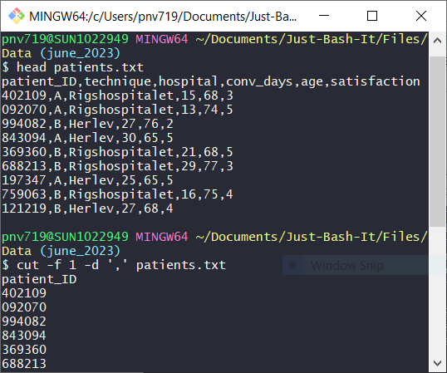
Cut – Getting columns out
Cut slices a column out of a file. What a ‘column’ is, depends on the field separator.
$ cut –f 1 –d ',' patients.txt
We can also specify a range of columns:
$ cut –f 1-3 –d ',' patients.txt
The opposite of cut is paste, putting columns together.

Slide 69
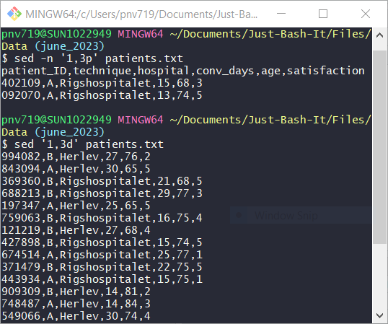
Sed – The stream editor
Sed is a powerful tool used to manipulate text files without the manual labor of a text editor.
A common use it to display only specific lines:
$ sed –n '1,3p' patients.txt
Or to delete them!
$ sed '1,3d' patients.txt
Note that we haven’t saved the output, it is just displayed. The file itself still has all lines.
The most powerful use of sed however is to edit file contents with regular expression!

Slide 70
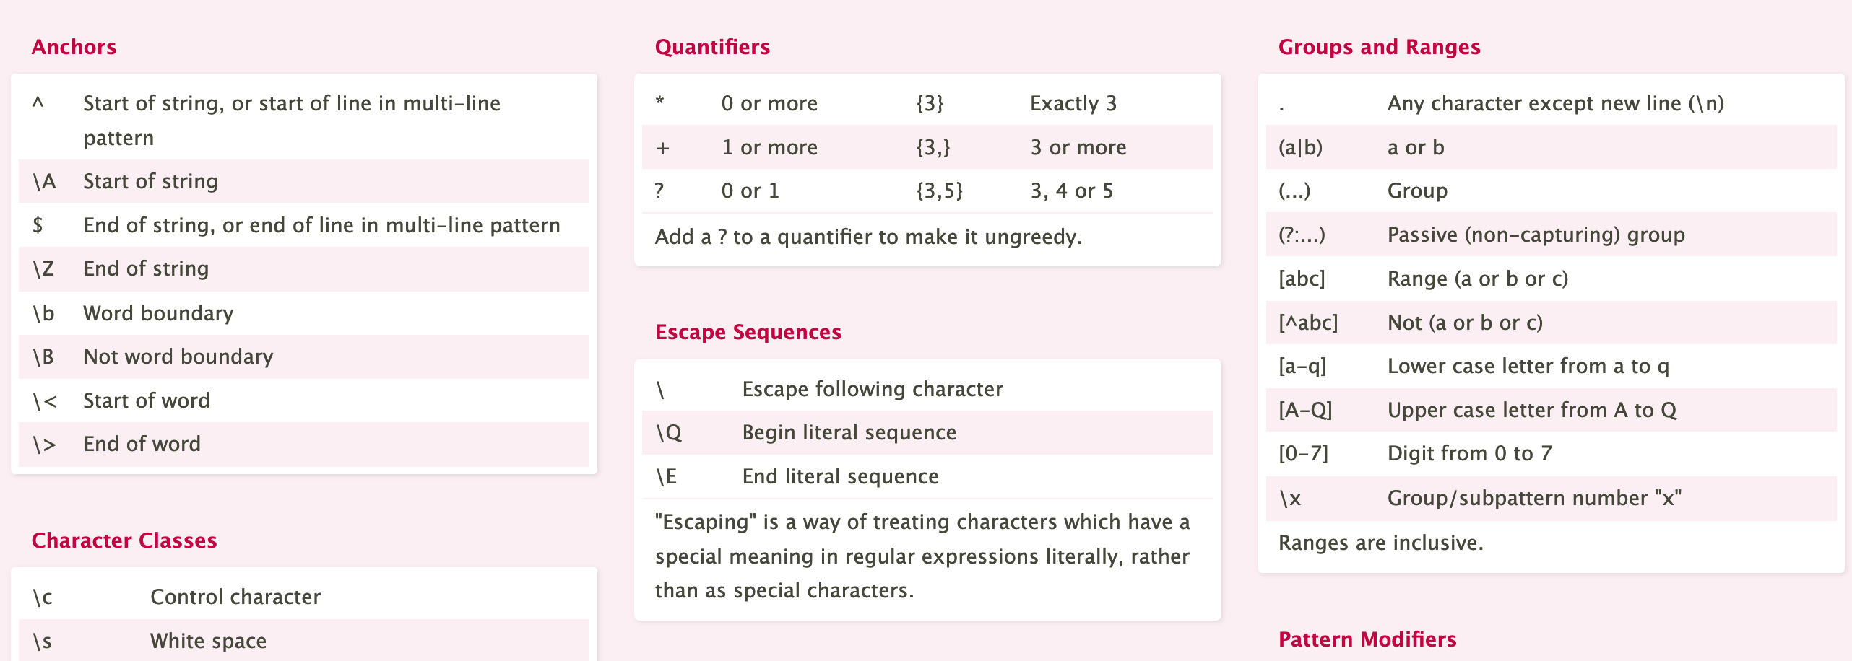
REGULAR EXPRESSIONS
Regular expression (RegEx) = sequence of characters that specify a flexible search pattern
https://cheatography.com/davechild/cheat-sheets/regular-expressions/
Regex Testers :
https://regexr.com/
https://regex101.com/

Slide 71
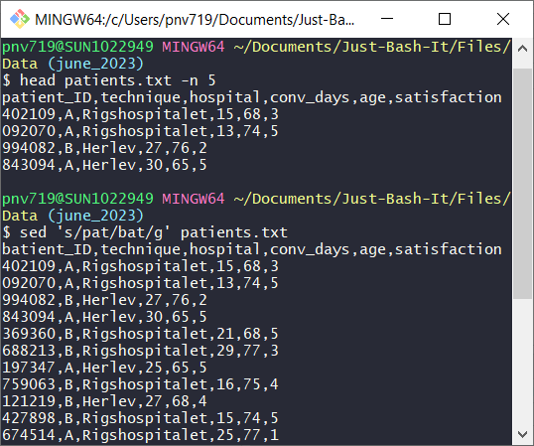
Sed – The stream editor
Sed can be used to search for and replace patterns. Here we’re changing ‘pat’ to ‘bat’:
$ sed 's/pat/bat/g' patients.txt
By using anchors we can be more specific about the exact pattern we want to hit:
$ sed 's/^40/XX/g' patients.txt
You should always be as specific as possible to avoid changing parts you didn’t want to.
You can find many examples for using sed on
the internet, i.e. here: https://www.howtogeek.com/666395/how-to-use-the-sed-command-on-linux/

Slide 72
CHEAT SHEET 5
View Files
Compressed Files
less [file] # view file content
cat [file] # view file content (full)
head / tail -n 10 [file] # view n first/last lines
nano [file] # https://www.nano-editor.org/dist/latest/cheatsheet.html
vim [file] # https://vim.rtorr.com/
tar -[f] [file] # .tar files
gzip -[f] [file] # (de)compress (.tar).gz files
unzip -[f] [file] # decompress .zip files
zless -[f][file] # view .gz file w/o decompression
gunzip -[f] [file] # uncompress and keep original
others: zcat, zmore, gzcat
Manipulating Files
wc -[f][file] # Count lines, characters, bits
sort -[f][file] # Sort file (by field/column)
uniq -[f][file] # Return unique values
cut -[f][file]: # Extract field/column
paste -[f][files]: # Merge file lines
sed -[f]'command'[file] # Insertion, deletion, …
grep -[f]['pattern'][file] # Search for pattern
awk '{pattern}'[file] # Search, replace, extract, …
find -[f][path]['pattern'] # Search pattern in file name

Slide 73
“
Last exercise for today, let’s go!

Slide 74
6. DATA WRANGLING 2

Slide 75
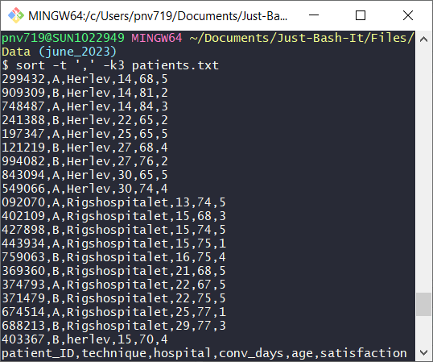
Sort – Exactly what it says on the tin
Sort produces a sorted output.
Here, we need to specify the field separator since the default separator in sort is a space. The column to sort on is given by -k.
$ sort -t ',' –k3 patients.txt
By default sort is alphanumeric, that means 10 is smaller than 9 since 1 < 9. To switch to numeric sort, use the -n option:
$ sort –t ',' –n -k4 patients.txt
The -n can also be placed directly with the -k4 to specify numeric sort on only this column. This matters when you sort by multiple columns.

Slide 76
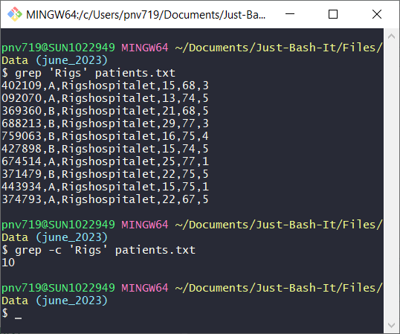
Grep – Looking for something
The grep command searches files for matches to the desired pattern and returns the entire line (unless you specify match only).
$ grep 'Rigs' patients.txt
It has a handy option for counting the number of matching lines:
$ grep -c 'Rigs' patients.txt
Grep also understands regex just as sed so you can make your patterns very exact. Sometimes you might need the –P option to get grep to compile the expression in Perl style

Slide 77
awk – The fix everything or die trying
awk is a domain specific language made of one-liners that is often used for file manipulation.
It can be used for selecting lines, cutting and pasting files together and even perform arithmetic on file content!
$ awk '/,5$/ {print}' patients.txt
$ awk -F ';' '{print $2,$3}' patients.txt
$ awk -F ',' '{if ($4 >15) {print}}' patients.txt
Why would you use awk instead of python or another general-purpose programming language? Because you can directly invoke it on the command line without needing a script and input/output file handling. It’s convenient!
Notes:
Domain specific language as opposed to general purpose programming languages like R and python
Now it’s mostly a commandline file manipulation tool

Slide 78
7. REDIRECTION & PIPES

Slide 79
A TALE OF THREE STREAMS
Data in unix always moves along one of three (data) streams:
stdin (Standard In) – the stream along which input to commands moves
stdout (Standard out) - the output of commands moves along this stream
stderr (Standard error) – error messages move via this stream
Each of the streams can be redirected separately.
stdin
Keyboard
Program
YEAH!
YOU HAVE A BASH SHELL & TERMINAL ALREADY.
stderr
Program
Display
stdout

Slide 80
A TALE OF THREE STREAMS
ls *
stderr
stdout (standard out) - the output of commands moves along this stream
stderr (standard error) – error messages move via this stream
By default stdout points to the display, your terminal window
Program
Display
stdout
Your terminal
BashFigure1.jpeg
Commandline_Workshop.pptx
Data
Examples
Just_Bash_It_Exercises.md
Just_Bash_It_Exercises.Rmd
Just_Bash_It_Presentations.md
Just_Bash_It_Presentations.Rmd
LICENSE

Slide 81
A TALE OF THREE STREAMS
But stdout and stderr can be redirected to i.e. a file:
Redirect stdout:
$ ls > list_results.txt
Redirect stderr:
$ ls 2> err.txt
Redirect both into different files:
$ ls 2> err.txt > list_results.txt
Redirect both into the same file:
$ ls &> both
ls *
stderr
Program
'2>' will redirect
stderr.
'>'
Display
Your terminal
stdout
File

Slide 82
A TALE OF THREE STREAMS
stdin
Keyboard
Many commands require input data to work on, i.e. wc works on a file.
Usually input data comes from the keyboard, i.e. the name of the file to word count.
But it can also come directly from another program!
Program
YEAH!
YOU HAVE A BASH SHELL & TERMINAL ALREADY.
stderr
Program
Display
stdout

Slide 83

CHAINING (PIPING) COMMANDS
file1.txt
$ wc *.txt > file_lengths
wc *
file2.txt
$ sort –n file_lengths
file3.txt
But now we have an intermediate file we don't need!
File1.txt 10
File2.txt 5
File3.txt 8
sort

Slide 84
CHAINING (PIPING) COMMANDS
Instead we can use a pipe:
file1.txt
wc *
file2.txt
$ wc *.txt | sort –n
file3.txt
File1.txt 10
File2.txt 5
File3.txt 8
sort

Slide 85
CHAINING (PIPING) COMMANDS
wc *
sort -n
List of files and their number of words
Sorted list of files and their number of words
$ wc *.txt | sort -n
stdout
stdin
stdout
Pipe
Display
pipe symbol = |

Slide 86
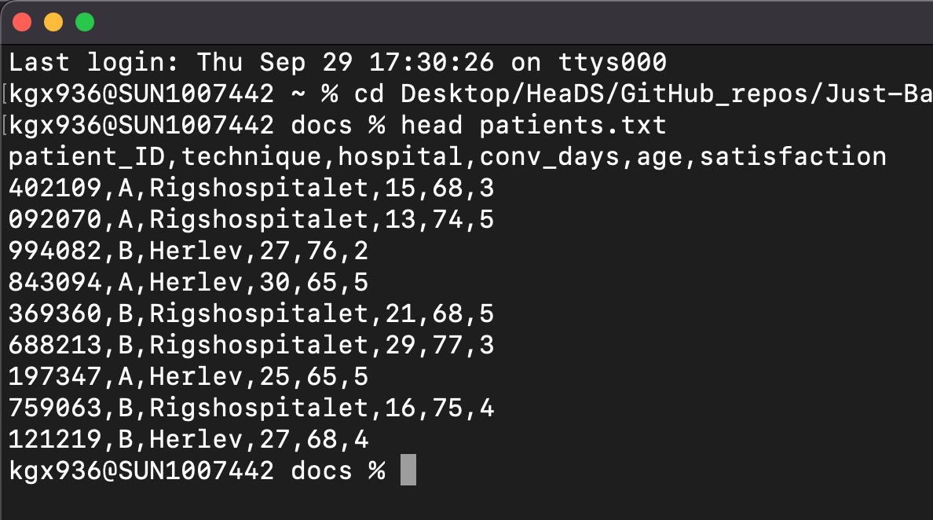
CHAINING (PIPING) COMMANDS
Some examples:
Take the second column and count how often each element occurs:
$ cut -d ',' -f 2 patients.txt | sort | uniq -c
Get only lines containing 'Herlev' and sort by age:
$ grep 'Herlev' patients.txt | sort -t ',' -n -k5
If we don’t want the entire line we could also cut out the age column before sorting:
$ grep 'Herlev' patients.txt | cut -d ',' -f 5 | sort -n

Slide 87
CHEAT SHEET 2
View Files
Compressed Files
less [file] # view file content
cat [file] # view file content (full)
head / tail -n 10 [file] # view n first/last lines
nano [file] # https://www.nano-editor.org/dist/latest/cheatsheet.html
vim [file] # https://vim.rtorr.com/
tar -[f] [file] # .tar files
gzip -[f] [file] # decompress (.tar).gz files
unzip -[f] [file] # decompress .zip files
zless -[f][file] # view .gz file w/o decompression
others: zcat, zmore, gzcat
Manipulating Files
wc -[f][file] # Count lines, characters, bits
sort -[f][file] # Sort file (by field/column)
uniq -[f][file] # Return unique values
cut -[f][file]: # Extract field/column
paste -[f][files]: # Merge file lines
sed -[f]'command'[file] # Insertion, deletion, …
grep -[f]['pattern'][file] # Search for pattern
awk '{pattern}'[file] # Search, replace, extract, …
find -[f][path]['pattern'] # Search pattern in file name

Slide 88
8. SHELL SCRIPTS & LOOPS

Slide 89
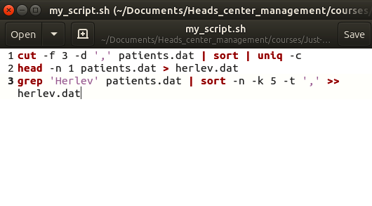
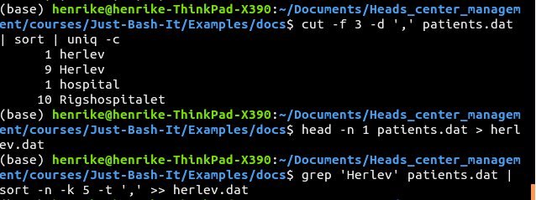
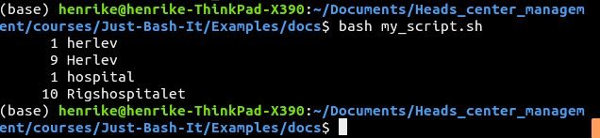
WRITING SCRIPTS
Save your commands for later use!
Re-run anytime, always same result
Check your script if you don't remember the steps of an analysis
Back-up your scripts on i.e. github, KU drive, ect.

Slide 90
COMMAND LINE INPUT
Add arguments when you execute your script, these will be passed to it.
Useful if you want to i.e. specify the file you want to run the script on.
A script is called with bash (or simply sh).
The first argument after the script name will be $1 inside the script.
The second argument will be $2 and so on.
# Comment line script 1
# Usage: sort_this.sh file_name
sort -n $1
# Comment line script 2
# Usage: cut_col file_name column_number
cut -d ',' -f $1 $2
$ bash sort_this.sh patients.txt
$ bash sort_this.sh my_textfile.txt
$ bash cut_col patients.txt 3

Slide 91
LOOP IN BASH
#example of a for loop in bash
for file in *.txt
do
echo $file
wc $file
done
#the general syntax of a for loop is:
for [iterator] in [generator]
do
commands
done
Loops allow you to repeat the same action several times, once for each file for example.
Many bash commands can be run on several files, i.e.
$ wc *.txt
However, a loop is useful if you want to execute several commands for each file.

Slide 92
OTHER SCRIPTING
$ bash my_script.sh
This is a bash script. It's basically just a text file but we tell the computer to use bash to interpret it by calling it with 'bash my_script.sh'
We can also run scripts in other languages from the command line, i.e. python:
Scripts in the R language are called with the command ‘Rscript':
You need to have R and python installed on your computer in order to be able to call them on the command line.
$ python align_reads.py
$ Rscript deSEQ_cancer_Data.R

Slide 93
9. SOFTWARE INSTALLATION UPKEEP & MORE

Slide 94

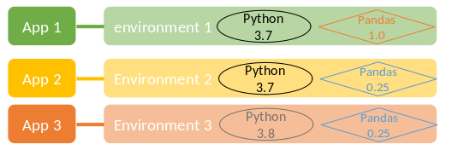

Conda is an open source package & environment management system.
Many softwares exist as conda packages, you can use conda to install them and their dependencies.
An environment is a specific combination of packages in a specific version.
IF you do not update the packages, running an analysis in the same environment will give the same result.
PROS
Comprehensive, many options
Environment management
Well documented
CONS
Can be overwhelming

Slide 95

APT-GET
Homebrew - source software package management system, for OS X, Ubuntu (Linux).
NOT an environment manager, package manager only.
Creates separate directories for libs and configurations, adds symlinks to user/local.
Manage all installed softwares via the terminal, install, check, update, remove…
apt-get is a command-line tool for handling packages in Linux (Ubuntu, ‘Windows’).
APT = Advanced Packaging Tool
Upgrade and remove of packages along with their dependencies.
NOT an environment manager, package manager only.
PROS
CONS
PROS
CONS
Easy to use
Good documentation
Commands a few and logical
Packages, NOT environments
Works like any linux command
No installation (is default)
Robust to OS updates
Packages, NOT environments

Slide 96
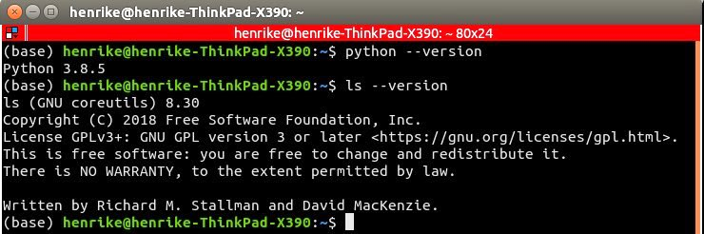
SOFTWARE VERSION
You can generally check the version of installed software with:
[name of software] --version

Slide 97



KEEPING THINGS UP TO DATE
Update your software with the same tool you used to install it:
Installed with conda: (update only the current environment)
$ conda update [software]
Installed with homebrew (updates a software):
With Windows App store:
Update via
Windows App store
$ brew upgrade [software]
Installed with apt-get:
$ apt-get update [software]

Slide 98
OPENING APPS & RUNNING SOFTWARE
Some, but not all files can be opened without specifying an app.
Many apps can be launched with open -a.
Some softwares are designed to run on both the command line and in a GUI, while others are specific to one.
1. open myfile.xlsx
2. open -a 'Google Chrome'
Monitor processes, find them, check memory & ‘kill’ them when necessary:
3. man open
$ top (htop)
$ ps aux (processes for all users)
$ grep 'Google Chrome'
$ kill [pid]

Slide 99

CONFIGURATION FILES
UBUNTU - BASH SHELL
/etc
/User
Config files are used to specify parameters, options, settings and preferences applied to your OS or a software.
Types of config files; system-wide, program-specific, user-specific.
Extension will pertain to what is configured.
Rarely permission to change system-wide files. Software-specific files you can usually edit.
N.B config files are ‘hidden’, i.e. ls -la (or similar) to see them.
.profile
.profile
.bashrc
.bashrc
.bash_profile
.bash_profile
OS X - Z SHELL (BASH +)
/etc
/User
.zprofile
.zprofile
.zshrc
.zshrc
.zsh_profile
.zsh_profile
https://landoflinux.com/linux_bash_configuration_files.html

Slide 100
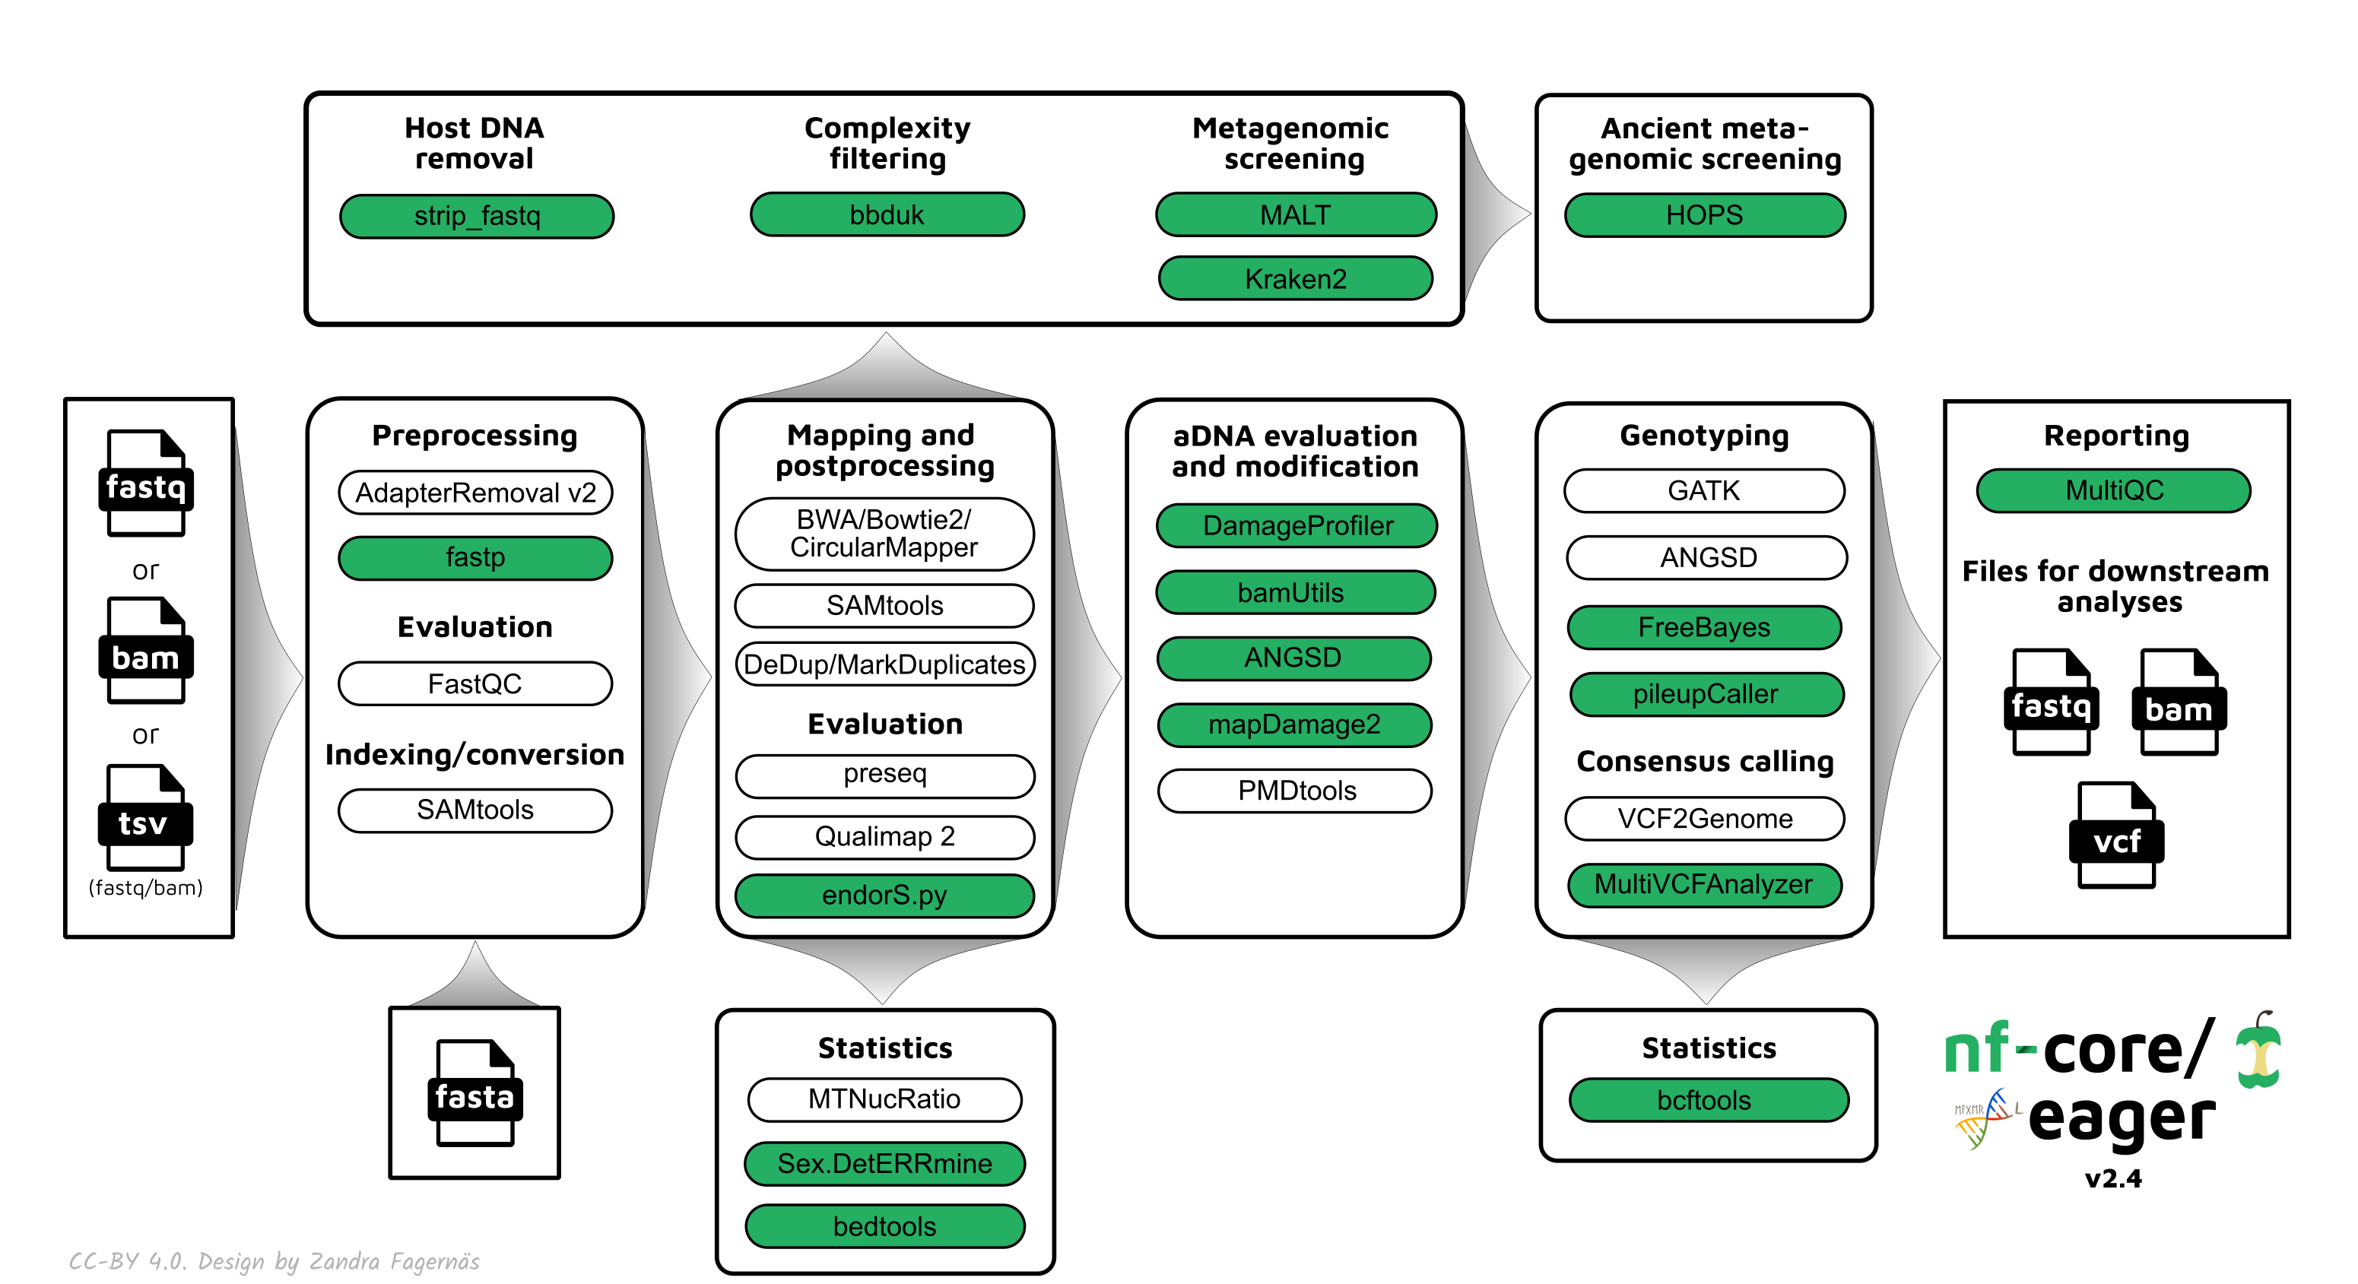


WORKFLOW LANGUAGES
Workflow languages:
Tools to create reproducible pipelines - more robust than bash scripts.
Workflow languages allow you to:
Control the flow of your pipeline
Restart at various defined points.
Ensure previous commands have. executed without error.
Logging & Reporting of your job.
snakemake
https://snakemake.readthedocs.io/en/stable/
https://www.nextflow.io/

Slide 101

THANK YOU FOR TODAY

